Slide 1


Fashion Recommend for Daily
2 0 1 8
Software
Engineering
Faredy
Group 6
홍기환 2013314099
김상우 2012314413
윤현철 2015314758
김명준 2014311021
이지현 2016311438
Aproov 2018318979
이창훈 2016314078

Slide 2
Contents
Background
Related services
Development
System Objectives
Technical Backgrounds
Expectancy Effect

Slide 3
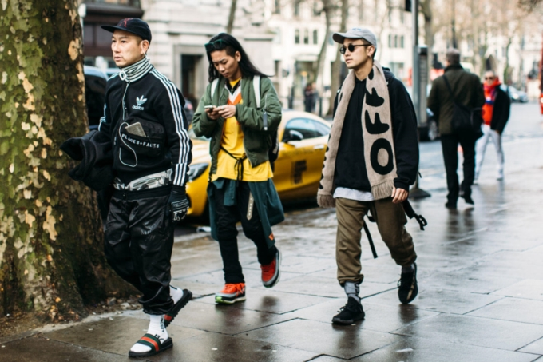
Faredy
Background
2 0 1 8
Software
Engineering
Why do we focus on ‘Streaming’?
▶ Today’s people are instantly curious about things that unintentionally stimulate me rather than referrals to the majority.
Fashion
Recommend
for Daily
Background
System
Objectives
Related
Services
Technical
Background
Development
What’s that dress?
Expectancy
Effect

Slide 4
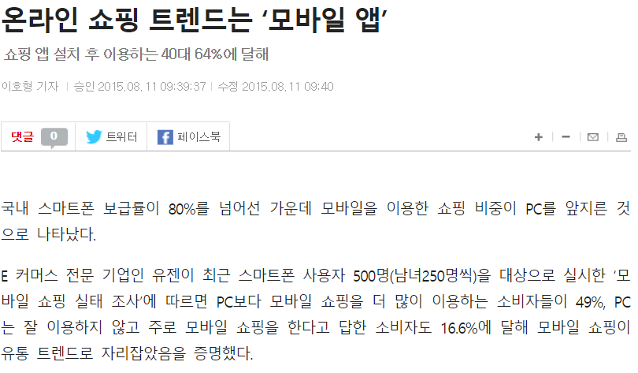
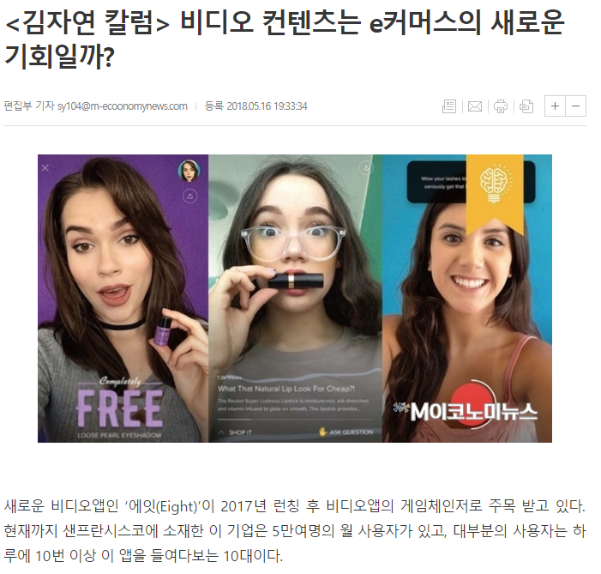
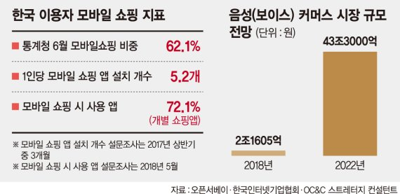
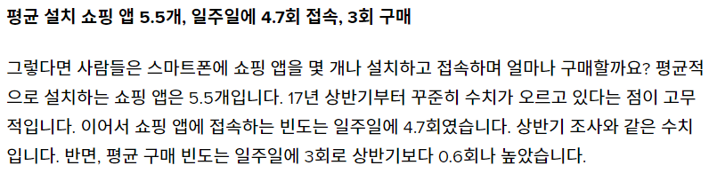
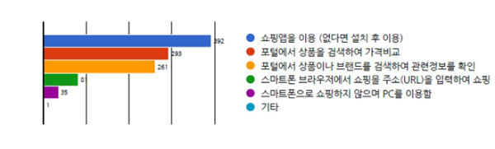
Faredy
Background
2 0 1 8
Software
Engineering
Fashion
Recommend
for Daily
Trend of
Shopping
Background
System
Objectives
Related
Services
Technical
Background
Development
Expectancy
Effect

Slide 5
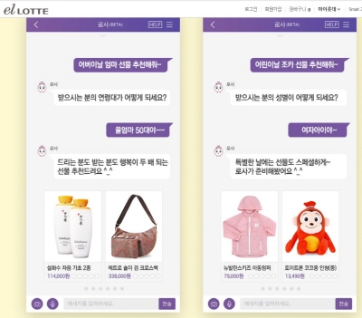
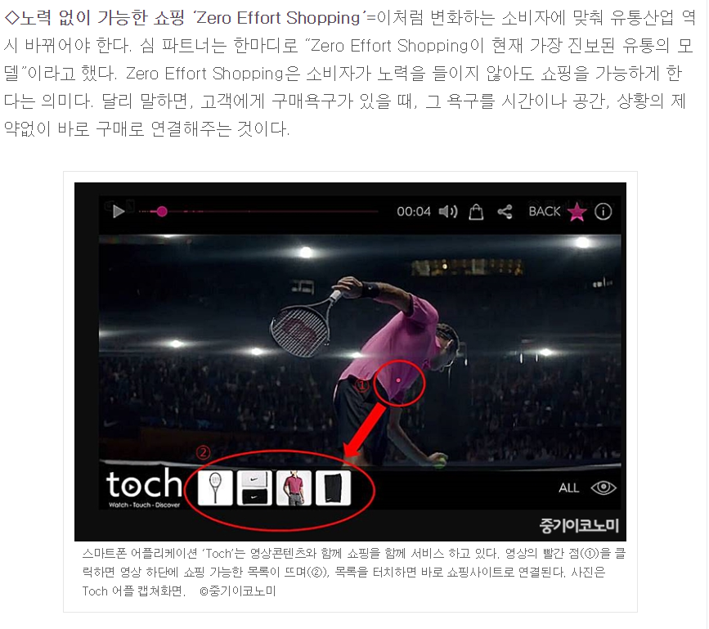
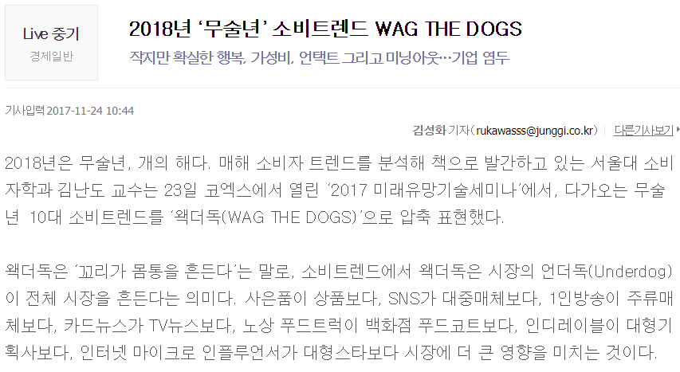
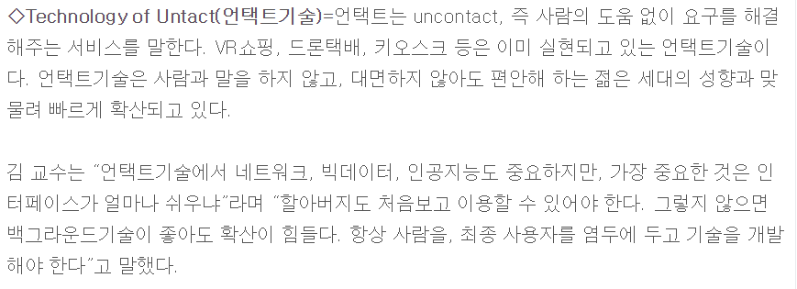
Faredy
Background
2 0 1 8
Software
Engineering
Fashion
Recommend
for Daily
Background
System
Objectives
Related
Services
Technical
Background
Development
Trend of
Shopping
Expectancy
Effect

Slide 6



Faredy
System Objectives
Streaming
▶ They want to find clothes that they like when walk on the street or take a photo from magazine beyond finding and buying favorite clothes to do window shopping.
2 0 1 8
Software
Engineering
Fashion
Recommend
for Daily
Background
Customizing
▶ Consumption of preference centers increases more than fashion. They want to find clothes that are better suited to their than they are, or that they are more interested in, than following the clothes of the store.
System
Objectives
Related
Services
Technical
Background
Development
Life Curation Service
▶ Service that recommends individual personalized products by grasping the main target’s interest and purchase pattern based on big data for the customers who have so-called choice disorder due to content overflowing in mobile environment.
Expectancy
Effect

Slide 7

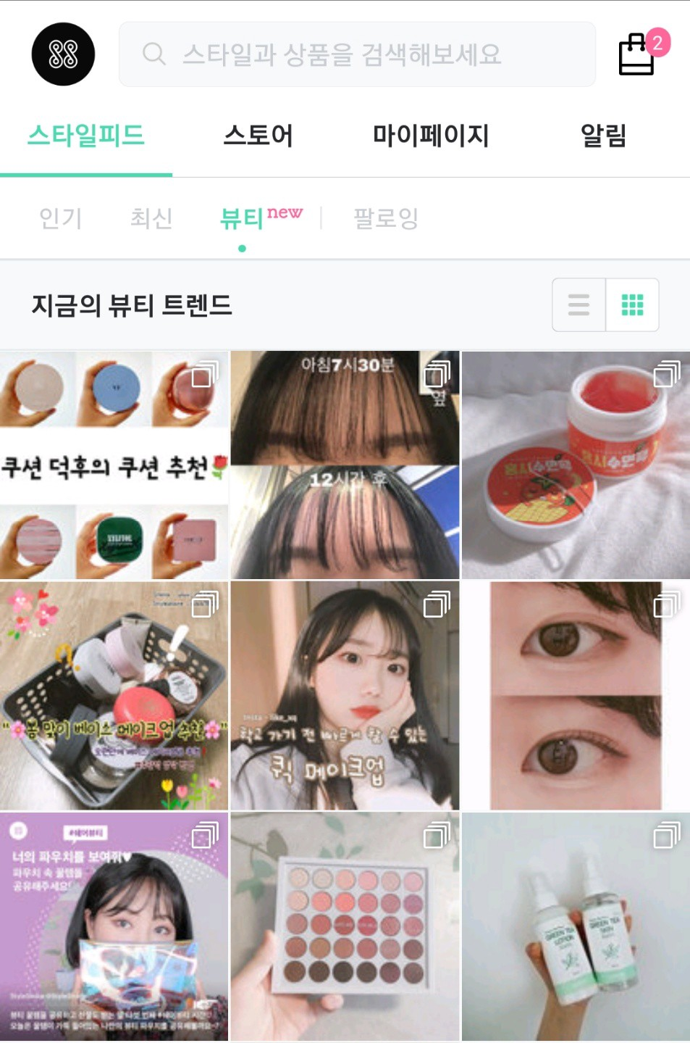
Faredy
Related Services
There is ‘Stylefeed’ that follows people to post articles about fashion/beauty/flip-market/shopping mall and follow up on items of interest.
The shopping mall is like a recommendation according to the age and gender you entered when you first joined, and if you select the desired clothes, you will be moved to the corresponding shopping mall.
Beauty determines the beauty rankings through user’s ranking and related keyword search ranking, and if you select the desired product, the corresponding post will come out and you will immediately follow the purchase link like shopping mall.
Store boxes are divided into large categories such as women/unisex, and the shopping keywords that are floating every hour are updated to show the keywords of the fashion that most people are going to buy and the corresponding products.
Various feeds and categories of referral products are adjusted through the keywords I’ve searched for or the details I have purchased, and when I want to get rid of them and return to the initial state, I can clear the cache.
2 0 1 8
Software
Engineering
Fashion
Recommend
for Daily
Background
System
Objectives
Related
Services
Technical
Background
Development
Expectancy
Effect

Slide 8

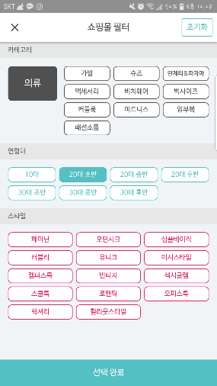
Faredy
Related Services
2 0 1 8
Software
Engineering
Fashion
Recommend
for Daily
There’s ‘shopping mall filter’ that shows ranking depends on selected clothes, age, and style. This filter affects when user searches.
‘Product feed’ recommends all the similar, popular, new products that are related to user selection.
In user selection box, when user drags down the product, it recommends the products that has same style of it.
Background
System
Objectives
Related
Services
Technical
Background
Development
Expectancy
Effect

Slide 9

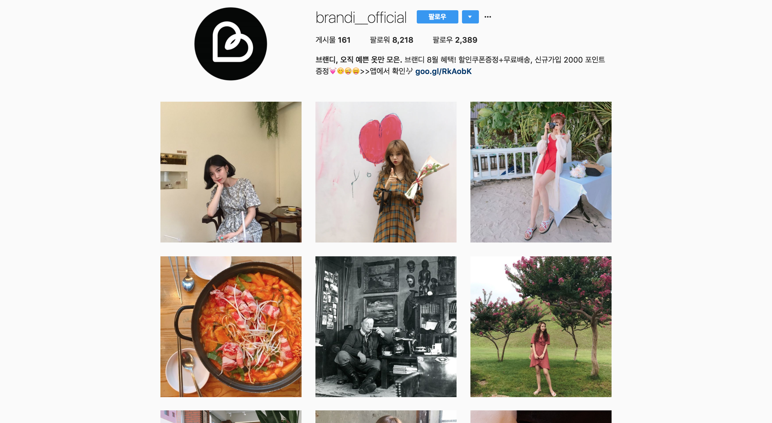
Faredy
Related Services
2 0 1 8
Software
Engineering
Fashion
Recommend
for Daily
Free shipping
Similar as zigzag(previous slide) it recommends similar style clothes. And also recommends the popular products that are in same category of selected one.
Background
System
Objectives
Related
Services
Technical
Background
Development
Expectancy
Effect

Slide 10

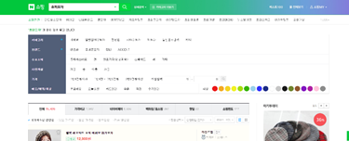
Faredy
Related Services
2 0 1 8
Software
Engineering
Fashion
Recommend
for Daily
The category of product is not only seller, style, designer, but also kids, pet, foods and other else are exists.
When choosing product, it shows the lowest price which is comparison of all sellers
When searching, filters are not limited. From age, style, and furthermore brand, pattern, color and length
Background
System
Objectives
Related
Services
Technical
Background
Development
Expectancy
Effect

Slide 11
Faredy
Technical Background
2 0 1 8
Software
Engineering
 | Our Service | Style-Share | Zig-Zag | A-Bly | Naver Shopping | Musinsa
SNS | O | O | X | O | X | O
Customizable | O | X | X | X | X | X
Community | O | X | X | X | O | X
Recommendation | O | O | O | X | X | O
Link | O | O | O | X | O | O
Keyword | O | O | O | O | O | O
Fashion
Recommend
for Daily
Background
System
Objectives
Related
Services
Technical
Background
Development
Expectancy
Effect

Slide 12


Faredy
Technical Background – Front/Back and Development
2 0 1 8
Software
Engineering
Back-end Development
MySQL : for database management
Google cloud : hosting web service
Fashion
Recommend
for Daily
Background
Front-end Development
Web based
System
Objectives
Related
Services
Technical
Background
Development
Expectancy
Effect

Slide 13
Faredy
Technical Background – Algorithm & API
2 0 1 8
Software
Engineering
• Algorithm
- Machine-learning : Image feature extraction
Color, sleeve-sleeveless, top-bottom and other feature extraction
- Collaborative filtering : statistics based recommender system
Something favorable = Item that user who resembles to me likes.
Using Latent Factor Model
• API
Facebook & Naver : login service
Fashion
Recommend
for Daily
Background
System
Objectives
Related
Services
Technical
Background
Development
Expectancy
Effect

Slide 14






Faredy
Technical Background – Flow Chart
When find a clothe you want
Searching clothes using client’s picture
2 0 1 8
Software
Engineering
Collect data for Personalization service.
Make a list based on your picture
Our service recommend
For you
Fashion
Recommend
for Daily
Search and Match the clothe picture
Get clothes data
Service
Background
Gather data of clothes from sellers
Take a picture, and Upload it to our service
System
Objectives
Related
Services
When determine buying
Easy purchasing
Technical
Background
Development
Choosing by one click
Take an detailed order
Expectancy
Effect
Shopper
Service
Seller
Using reserved customer information
Delivery product
To customer directly

Slide 15
Faredy
Technical Background – Flow Chart
When need some recommendation
Collected data for Personalization service.
2 0 1 8
Software
Engineering
Recommendation Personalizing
Fashion
Recommend
for Daily
Our service recommend for you
Make recommendation only for you
Shopper
Service
Search your preference include searching data, order record, etc.
Background
Gathered data of clothes from sellers
System
Objectives
When people selected clothes
Trend recommendation
Related
Services
Technical
Background
Purchase by one click
Take an detailed order
Shopper
Service
Seller
Batch Processing trend information
Development
Purchase by one click
Using reserved customer information
Take an detailed order
Delivery product
To customer directly
Shopper
Service
Seller
Expectancy
Effect
Using reserved customer information
Delivery product
To customer directly
Purchase by one click
Take an detailed order
Shopper
Service
Seller
Service
Shopper
Using reserved customer information
Delivery product
To customer directly
You could acquire the hot-trend list
Collecting information what customers want

Slide 16

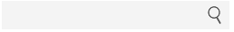

Faredy
Development - Homepage
2 0 1 8
Software
Engineering
Homepage
In this page, we offer overall functionality of our services. It connects about five pages. Login, signup / Find the clothes from pictures / Recommend the clothes from analysis / Best clothes these days / community.
Faredy
Log In
Sign Up
Basket
community
Fashion
Recommend
for Daily
What do I wear today?
What is the best selling?
What kind of clothes?
New
Hot
Best
Background
System
Objectives
Related
Services
Technical
Background
Development
Expectancy
Effect

Slide 17
Faredy
Development – Register & Log in page
2 0 1 8
Software
Engineering
Log in, Sign up
In this page, we offer login and signup functionality. Members can login with their id and password, but new customers can choose two option, one is just log in with facebook, and the other is signing up and log in.
Your Own Stylist
Log In
Sign Up
Basket
community
Fashion
Recommend
for Daily
What do I wear today?
What is the best selling?
What kind of clothes?
Log in
Background
Member Log in
System
Objectives
Id
password
Related
Services
Log in
Technical
Background
Facebook log in
Sign Up
Development
Expectancy
Effect

Slide 18
Faredy
Development – Differentiation from Existing Services
2 0 1 8
Software
Engineering
What kind of clothes?
In this page, we offer the services which find the clothes matching the picture. The picture may be from magazine or daily life. Then we analyze the picture and then show the pictures matching uploaded pictures. Then we save that features in their information. It will be used for recommendation later.
Faredy
Log In
Sign Up
Basket
community
Fashion
Recommend
for Daily
What do I wear today?
What is the best selling?
What kind of clothes?
Upload your picture
Show similar clothes
Background
Find your picture
System
Objectives
Search
picture
Related
Services
Select
Select
Technical
Background
Upload
Development
Expectancy
Effect

Slide 19
Faredy
Development – Redcommend
2 0 1 8
Software
Engineering
What do I wear today?
In this page, we offer the services which recommend the clothes with analysis. The sources are from the data of customers who have similar tendency.
Faredy
Log In
Sign Up
Basket
community
Fashion
Recommend
for Daily
What do I wear today?
What is the best selling?
What kind of clothes?
Check tendency
Recommend clothes
Background
System
Objectives
Related
Services
Select
Select
Technical
Background
save
Development
Expectancy
Effect

Slide 20
Faredy
Development – Best selling page
2 0 1 8
Software
Engineering
What is the best selling?
In this page, we offer the services which recommend the most chosen clothes. In our community or facebook, Instagram, we can gather the data which is the most chosen and we show them.
Faredy
Log In
Sign Up
Basket
community
Fashion
Recommend
for Daily
What do I wear today?
What is the best selling?
What kind of clothes?
Check category
Recommend clothes
Background
System
Objectives
Related
Services
Select
Select
Technical
Background
save
Development
Expectancy
Effect

Slide 21
Faredy
Expectancy Effect
2 0 1 8
Software
Engineering
Search appropriate clothes
Customization
Leads to purchase
Market Activation
Fashion
Recommend
for Daily
Background
System
Objectives
Related
Services
Technical
Background
Development
Expectancy
Effect

Slide 22
Faredy
Expectancy Effect
2 0 1 8
Software
Engineering
Recommend
Recommend to clients as tendency analysis
Group those people by each tendency
Community
Community energization
Extended
Activating Group purchase
Managing system in upper view
Fashion
Recommend
for Daily
Background
System
Objectives
Related
Services
Technical
Background
Development
Expectancy
Effect

Slide 23
Faredy
Expectancy Effect – Revenue Model
2 0 1 8
Software
Engineering
Fashion
Recommend
for Daily
Background
System
Objectives
Related
Services
Technical
Background
Development
Expectancy
Effect
*Additional services includes group purchasing or AD removal service

Slide 24
Faredy
Expectancy Effect- Schedules
2 0 1 8
Software
Engineering
10월
11월
12월
Fashion
Recommend
for Daily
Proposal
Sub-system
Engineering
Validation
Verification
10/7
12/1 – 12/8
10/22 – 11/10
Background
Requirement
development
Design
Specification
Code & Test
Result
System
Objectives
10/8-10/10
11/11
12/9
Related
Services
Procurement
Integration
Final
Presentation
10/8 – 10/20
11/12-11/30
12/10- 12/12
Technical
Background
Concept
Design
Development
10/8 – 10/20
Expectancy
Effect
Requirement
Specification
10/21

